Slide 1
OXYTOCIC AGENTS

Slide 2
Oxytocics
Hastening or facilitating childbirth, especially by stimulating contractions of the uterus
Oxytocics are the drugs of varying chemical nature that have the power to stimulate the contraction of uterine muscles.
Also called Uterotonics

Slide 3
Used in
Induce or augment labour
Inducing abortion
Minimize bleeding from placental site - PPH

Slide 4
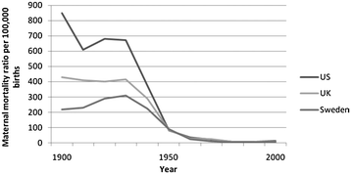
The introduction of oxytocic drugs for the treatment of Post Partum Hemorrhage (PPH) has been regarded as “ one of the enduring achievements of modern science”.
Maternal mortality, 1900–2000, in selected high-income countries

Slide 5
Oxytocics are divided in three different pharmacological groups:
1. Ergot alkaloids
2. Oxytocin
3. Prosraglandins

Slide 6
Ergometrine
“Treatment of excessive postpartum bleeding was attempted with vaginal packing, or with cold and later, more effectively, with hot vaginal douches, but the first effective treatment was with ergot, which caused uterine muscles to contract. This has been known of since the 16th century, but it was Oliver Prescott of Massachusetts who, in 1813, described its use for uterine haemorrhage. Extracts of ergot were given by mouth as ‘labour tea’; later ergot was used as an injection after the fetal head was born”

Slide 7
Ergometrine
Effects on the Uterus
Alkaloid derivatives induce TETANIC CONTRACTION of uterus without relaxation in between. These does not resemble the normal physiological contractions
It causes contractions of uterus as a whole i.e. fundus and cervix (tend to compress rather than to expel the fetus)
(Difference between oxytocin & ergots)

Slide 8
Ergometrine
Is used to contract uterus
Alpha adrenoceptor and dopamine receptor agonist
Acts immediately when injected iv
Faster uterine contractions superimposed on tonic contractions
Routinely used in the treatment and prophylaxis of PPH
Used intramuscularly.

Slide 9
Ergometrine
Side effects:
a) Nausea, vomiting, diarrhea
b) Hypertension
c) Vasoconstriction of peripheral blood Vessels (toes & fingers)
d) Gangrene

Slide 10
Ergometrine
Contraindicated..
for induction of labour and during the first and second stages of labour
In any suspicion of retained placenta
in eclampsia or preeclampsia
in patients with peripheral vascular disease or heart disease
with hypertension or a history of hypertension.
In impaired hepatic or renal function.

Slide 11
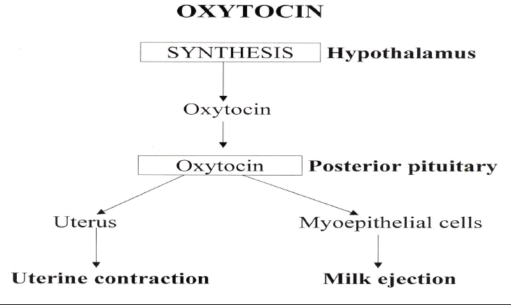
Oxytocin

Slide 12
Oxytocin
It stimulates the contraction of the pregnant uterus( more sensitive at term)
Oxytocin in small doses increases both the frequency and the force of uterine contractions.
At higher doses, it produces sustained contraction.
These contractions resemble the normal physiological contractions of uterus. (contractions followed by relaxation)

Slide 13
Oxytocin
Oxytocin is used in
the induction of labour
uterine inertia
Post partum haemorrhage
abortion

Slide 14
Oxytocin
Mechanism of action
Uterus - The interaction of endogenous or administered oxytocin , with myometrial cell membrane receptor promotes the influx of ca++ from extra cellular fluid and from S.R in to the cell , this increase in cytoplasmic calcium ,stimulates uterine contraction .
Breast
Kidney

Slide 15
Oxytocin
Pharmacokinetics
• Not effective orally
• Administered intravenously
• Also as nasal spray
• Not bound to plasma proteins
• Catabolized by liver & kidneys
• Half life = 5 minutes
• Duration of action – 1 hr (IV), 2-3 hr (IM)

Slide 16
Oxytocin
Side effects
Hypertension
Uterine rupture
Fetal death (ischaemia)
Water intoxication
Neonatal jaundice

Slide 17
oxytocin
Contraindications
Fetal distress
Prematurity
Abnormal foetal presentation
Cephalopelvic disproportion
Other predisposition for uterine rupture

Slide 18
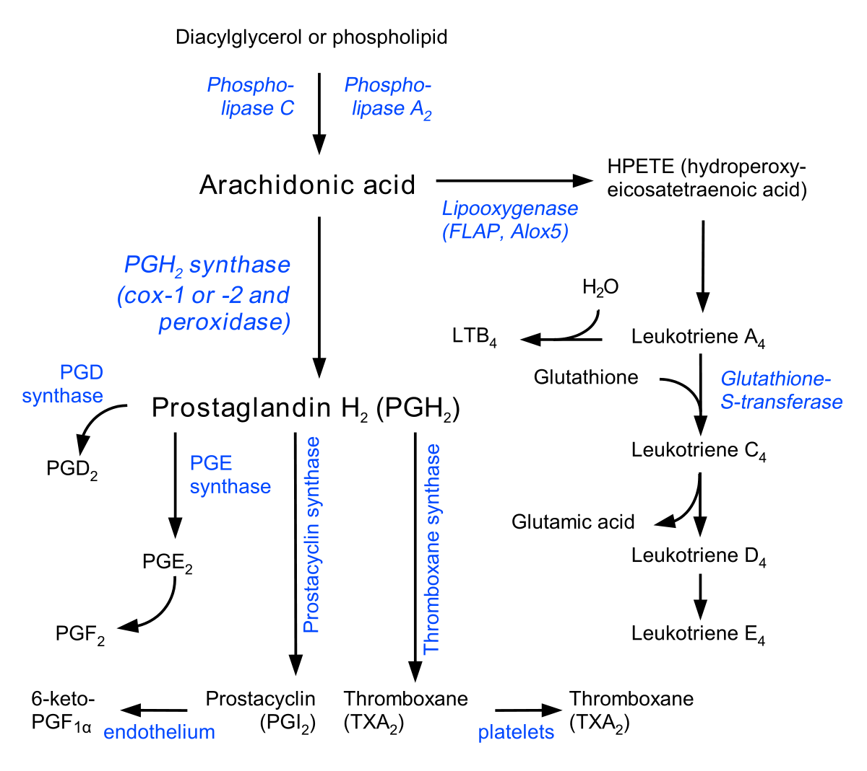
Prostaglandins

Slide 19
Prostaglandins
MECHANISM OF ACTION:
Contract uterine smooth muscle.
Prostaglandins cause uterine contractions by altering membrane permeability and increasing intracellular calcium .
They promote the formation of gap junctions, facilitating transmission of signals throughout the myometrium .
Additionally, they upregulate the expression of oxytocin receptors in the uterus which in turn promotes contractility

Slide 20
Prostaglandins
Difference between PGS and Oxytocin:
PGS contract uterine smooth muscle not only at term(as with oxytocin), but throughout pregnancy.
PGS soften the cervix; whereas oxytocin does not.
PGS have longer duration of action than oxytocin

Slide 21
Prostaglandins
Misoprotol – PGE1
Dinoprost - PGF₂α
Dinoprostone – PGE2
Gemprost – PGE1
Carboprost – PGF2

Slide 22
Prostaglandins in obstetric use
Soften the uterine cervix
Has powerful oxytocic effects
Used to induce labour
Termination of pregnancy
Treatment of Hydatiform mole

Slide 23
Prostaglandins
Intra or extra amniotic injection
Viginal tablets
Intracervical gel
iv infusion
Oral

Slide 24
Prostaglandins
Adverse effects
Vomiting
Diarrhoea
Headache
Bronchospasm
Flushing
Pyrexia
Local tissue reaction

Slide 25
Prostaglandins
Contraindications:
Mechanical obstruction of delivery
Fetal distress
Predisposition to uterine rupture
Precautions:
Asthma
Multiple pregnancy
Glaucoma

Slide 26
THANK YOU

